Slide 1




The 10% Campaign
How do changes in faculty effort percentages impact teaching – and your education?
Notes:
Moving to a standaized 10% could potentially increase the amount of classes you have to teach or reduce the time needed to prepare for these classes.
This could affect the quality of student eduction (over worked faculty, less time for each student, etc.)
This move is anti-labor, imposed unilaterally on faculty without union input.
We as Union and faculty have tried to address this internally, between the Union and Administration, but the amdinistration refuses to bring this to the bargaining table.

Slide 2
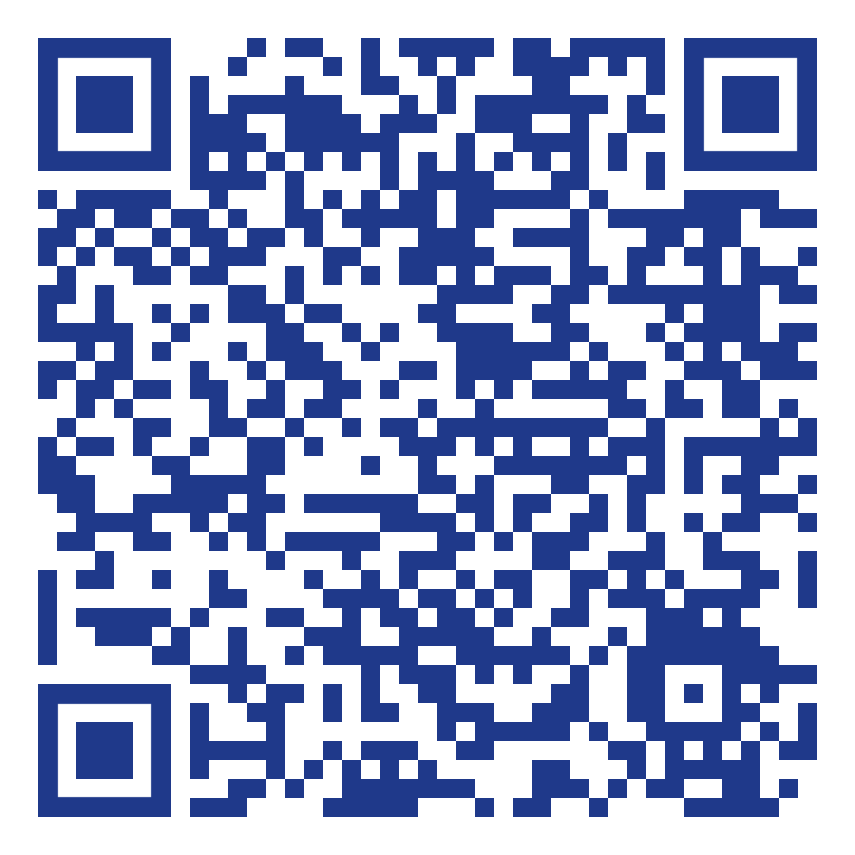
What you can do to support faculty?
Notes:
Scan the QR code and follow the link.
Input your details, this will direct you to a page that will allow you to email the administration expressing your support with faculty on this issue.
Click send letter.
Your voice has power and if the administration see students take a stand on this issue, they will rethink their decision.
Direct url - https://actionnetwork.org/letters/tell-uvm-no-to-lowering-our-education-quality?source=direct_link&

Slide 3
What you can do to support faculty?
Join faculty for a rally, on International Workers’ Day:
May 1st, 11:45am, Waterman Steps
Notes:
Encourage students to come to the rally!

